Slide 1
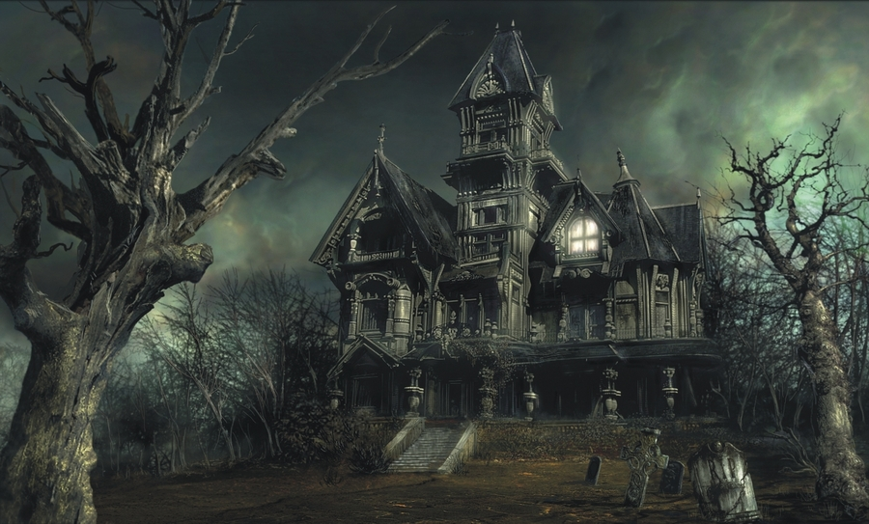
PYTHON HAUNTED HOUSE Part 3 this time it’s haunted

Slide 2
Randomness
We are going to create a collection of random items, and have them populate into random rooms. To do this we need some starting data.
A list of item names
A list of item descriptions
COPY to your Haunted House folder
Item_Desc.txt
Item_Names.txt
textfile.py
Textfile.py is going to be used over and over again so it makes sense to have it in it’s own separate module.

Slide 3
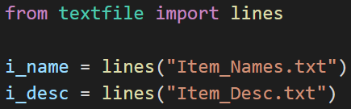
Data.py
Create a file called Data.py
This is going to load the data from our textfiles and save it into lists called i_name & i_desc

Slide 4
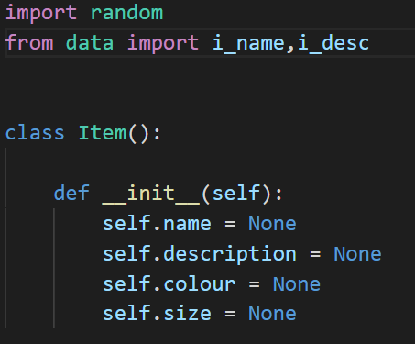
Item.py
We will need to edit our constructor to set all of the starting attributes to None. Don’t worry. We can still change them using our getters and setters
Make sure that you add in the imports to get our data from the module

Slide 5
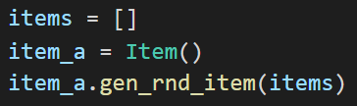
Main.py
We need to create a list to hold the items that are in our haunted house and empty items ready to be filled with data.
Create 4 more items underneath
gen_rnd_item is the name of the method in item.py we are about to make. We are going to need the list of items so we pass it as a parameter

Slide 6
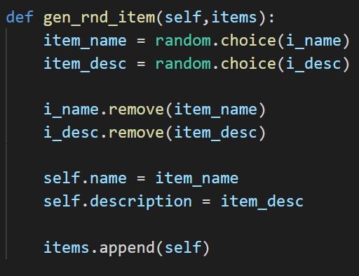
Item.py
We can now create a method that will generate a random item.
The first part selects a random item from the list and saves it as a variable
It is then removed from our list so each item is unique
The attributes are set to the value of the variables
The new item is added to the list of create items

Slide 7
Main.py
Huzzah we now have a list of random items created as objects. Now to put them into random rooms.
First of all we need to create a list for the rooms to be added to
Then add the rooms to the empty list
Do this now!

Slide 8
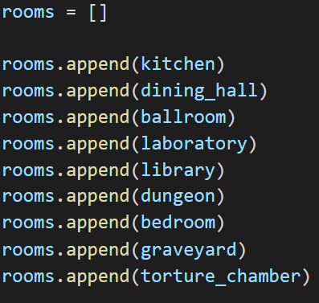
Main.py
Solution:

Slide 9
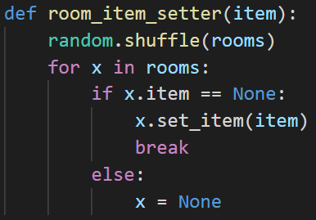
Main.py
We can now create a simple procedure in Main.py to add the items to the rooms.
X will take on the value of each room in our list
If the rooms item attribute is None then the item (passed as a parameter into the procedure) will be set to that attribute
DON’T FORGET
You will need to make sure that your rooms have an attribute to store the item in…

Slide 10

Main.py
To call our procedure we need to loop through our list of items

Slide 11
Items.py
We can slim down our code… OOOoooohhhh
By adding:
We can make sure the items attributes are generated randomly when the item is created.

Slide 12
Extension
Use this same technique to create random monsters and put them into random rooms

